Slide 1
Predict Diabetes
Final Project
111024509 陳冠霖
111024518 廖翊廷
111024524 李其炫

Slide 2

outline
EDA
Model & Summary
Conclusion
Responsibility
Resources & Reference

Slide 3
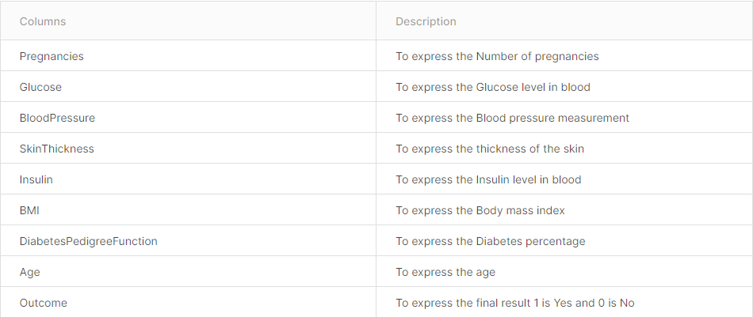
EDA

Slide 4

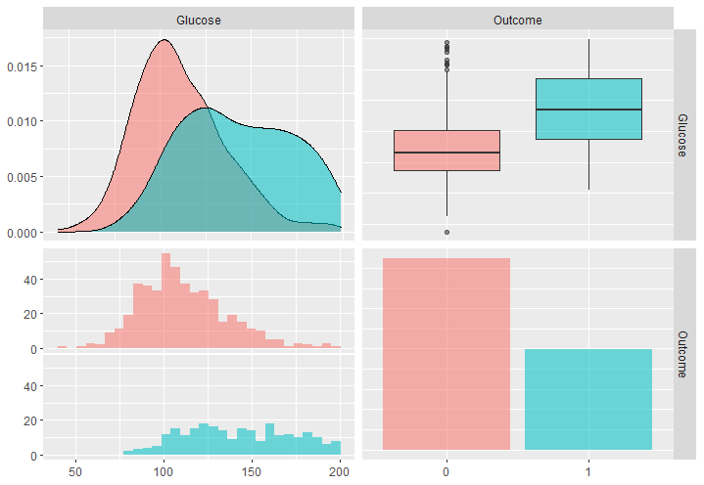
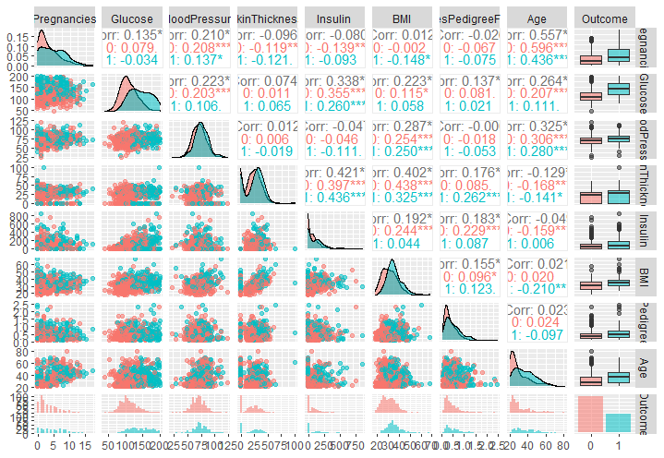


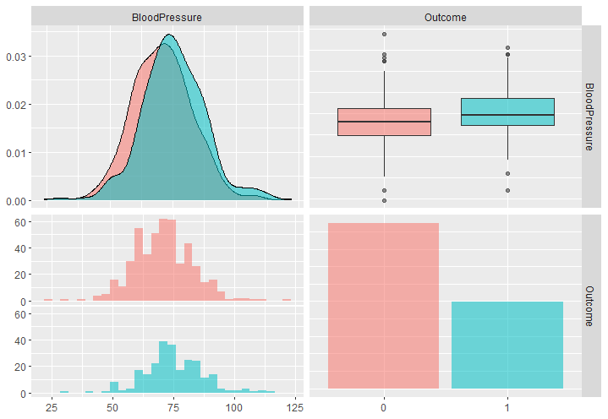
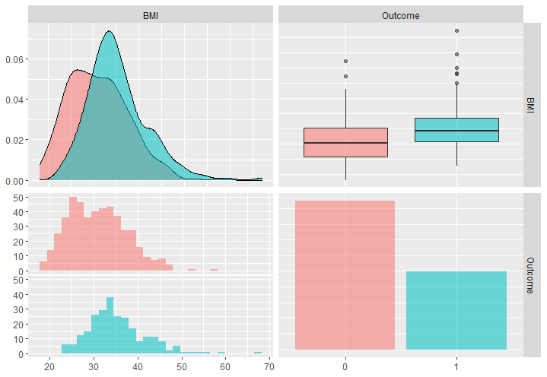
EDA

Slide 5
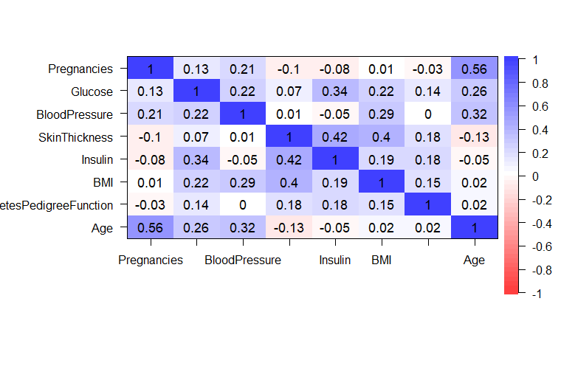
EDA

Slide 6


Model
Logistic regression
LDA
QDA
Naïve Bayes
Tree
Random Forest
Boosting
SVM (radial、 polynomial)

Slide 7
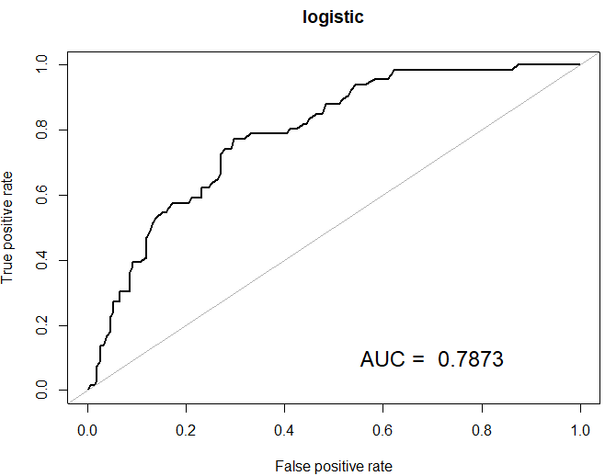

logistic regression
True
 | NO | YES
NO | 130 | 31
YES | 21 | 35
Prediction

Slide 8
logistic regression
Sensitivity | Specificity | Accuracy | AUC
0.5303 | 0.86093 | 0.76037 | 0.78728

Slide 9
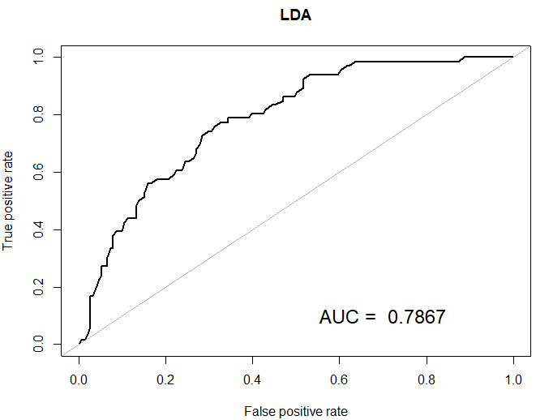
lda
True
 | NO | YES
NO | 128 | 33
YES | 23 | 33
Prediction

Slide 10
lda
Sensitivity | Specificity | Accuracy | AUC
0.5 | 0.84768 | 0.74194 | 0.78672

Slide 11
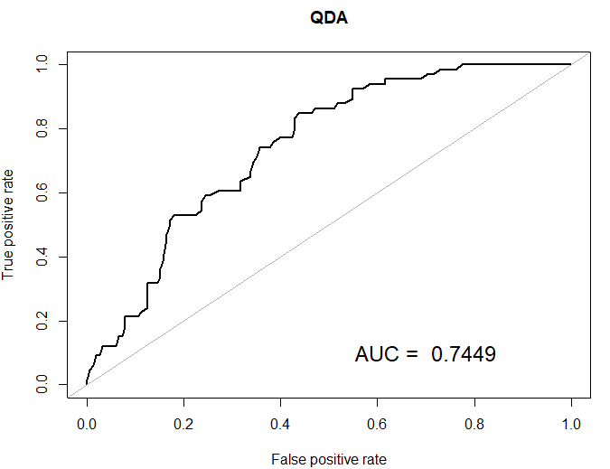
qda
True
 | NO | YES
NO | 117 | 31
YES | 34 | 35
Prediction

Slide 12
qda
Sensitivity | Specificity | Accuracy | AUC
0.5303 | 0.77483 | 0.70046 | 0.74493

Slide 13
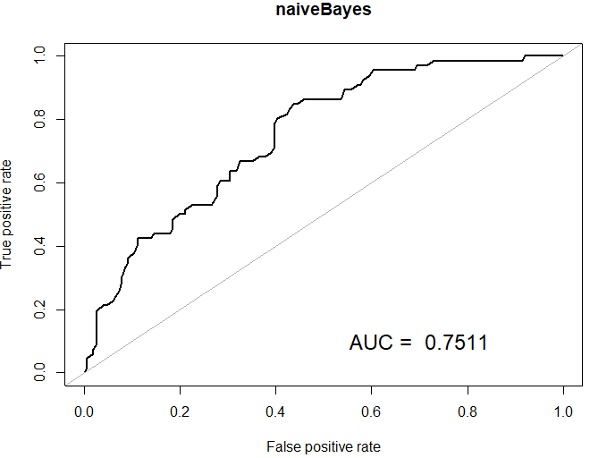
NAÏVE bAYES
True
 | NO | YES
NO | 123 | 34
YES | 28 | 32
Prediction

Slide 14
NAÏVE bAYES
Sensitivity | Specificity | Accuracy | AUC
0.48485 | 0.81457 | 0.71429 | 0.7511

Slide 15
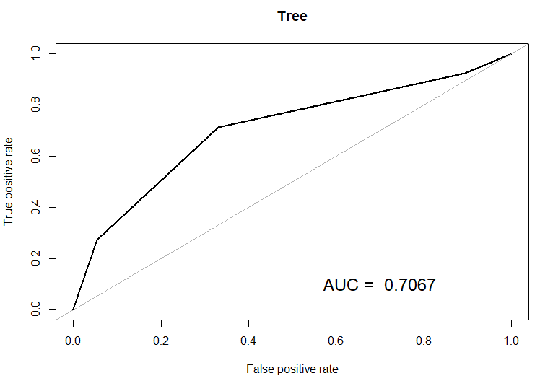
TREE
True
 | NO | YES
NO | 143 | 48
YES | 8 | 18
Prediction

Slide 16
TREE
Sensitivity | Specificity | Accuracy | AUC
0.27273 | 0.94702 | 0.74194 | 0.7067

Slide 17
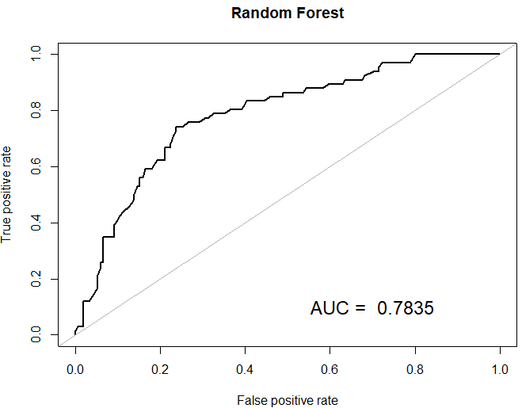
RANDOM FOREST
True
 | NO | YES
NO | 128 | 30
YES | 28 | 36
Prediction

Slide 18
RANDOM FOREST
Sensitivity | Specificity | Accuracy | AUC
0.54545 | 0.84768 | 0.75576 | 0.78351

Slide 19
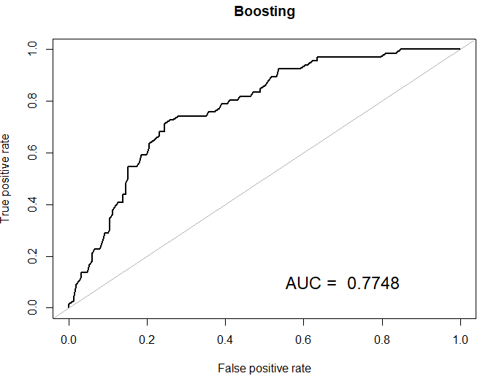
BOOSTING
True
 | NO | YES
NO | 127 | 30
YES | 24 | 36
Prediction

Slide 20
BOOSTING
Sensitivity | Specificity | Accuracy | AUC
0.54545 | 0.84106 | 0.75115 | 0.77483

Slide 21
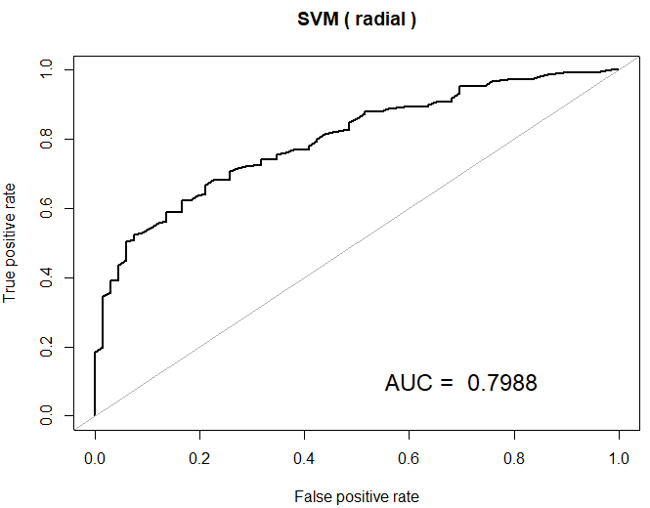
SVM ( RADIAL )
True
 | NO | YES
NO | 127 | 32
YES | 24 | 34
Prediction

Slide 22
SVM ( RADIAL )
Sensitivity | Specificity | Accuracy | AUC
0.51515 | 0.84106 | 0.74194 | 0.79877

Slide 23
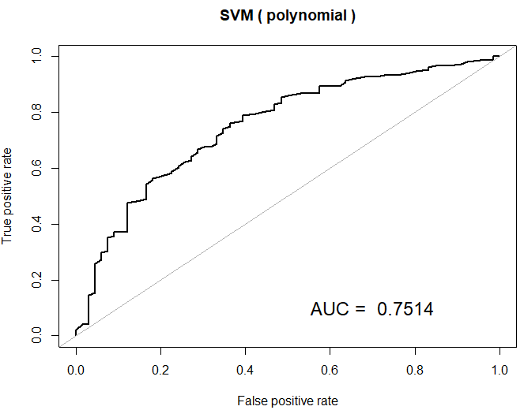
SVM ( POLYNOMIAL )
True
 | NO | YES
NO | 140 | 47
YES | 11 | 19
Prediction

Slide 24
SVM ( POLYNOMIAL )
Sensitivity | Specificity | Accuracy | AUC
0.28788 | 0.92715 | 0.73272 | 0.75140

Slide 25
conclusion
Cut point = 0.5 | Sensitivity | Specificity | Accuracy | AUC
Logistic | 0.53030 | 0.86093 | 0.76037 | 0.78728
LDA | 0.50000 | 0.84768 | 0.74194 | 0.78672
QDA | 0.53030 | 0.77483 | 0.70046 | 0.74493
Naïve Bayes | 0.48485 | 0.81457 | 0.71429 | 0.75110
Tree | 0.27273 | 0.94702 | 0.74194 | 0.70670
Random Forest | 0.54545 | 0.84768 | 0.75576 | 0.78351
Boosting | 0.54545 | 0.84106 | 0.75115 | 0.77483
SVM ( Radial ) | 0.51515 | 0.84106 | 0.74194 | 0.79877
SVM ( polynomial ) | 0.28788 | 0.92715 | 0.73272 | 0.75140

Slide 26
conclusion
CP = 0.3609467 | Sensitivity | Specificity | Accuracy | AUC
Logistic | 0.59091 | 0.76821 | 0.71429 | 0.78728
LDA | 0.60606 | 0.76821 | 0.71889 | 0.78672
QDA | 0.60606 | 0.72185 | 0.68224 | 0.74493
Naïve Bayes | 0.53030 | 0.73510 | 0.67281 | 0.75110
Tree | 0.71212 | 0.66887 | 0.68203 | 0.70670
Random Forest | 0.72727 | 0.76159 | 0.75115 | 0.78351
Boosting | 0.68182 | 0.76821 | 0.74194 | 0.77483
SVM ( Radial ) | 0.63636 | 0.76159 | 0.72350 | 0.79877
SVM ( polynomial ) | 0.56061 | 0.80132 | 0.72811 | 0.75140

Slide 27
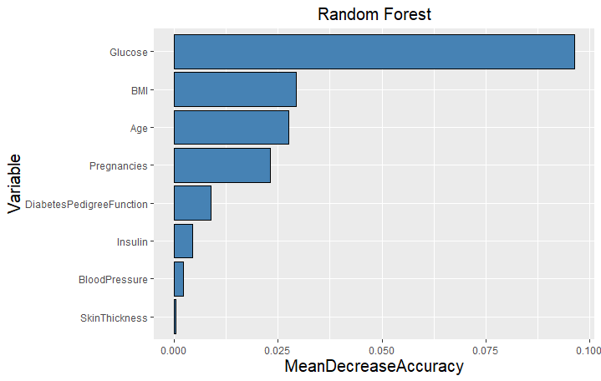
CONCLUSION

Slide 28
responsibility
陳冠霖
廖翊廷
李其炫
LDA
QDA
Naïve Bayes
統整所有結果
Tree
Random Forest
Boosting
SVM ( polynomial )
PPT製作
資料清洗
EDA
Logistic
SVM ( radial )
報告

Slide 29
Resources & Reference
homework
https://www.kaggle.com/datasets/whenamancodes/predict-diabities
https://www.analyticsvidhya.com/blog/2021/07/diabetes-prediction-with-pycaret/

Slide 30
Thank You！
∠( ᐛ 」∠)＿

